Slide 1
Beyond Language Barriers: Strategies to Engage with Latinx Communities Cintia Aguilar and Roberto Rosales
Virtual Idea Symposium
Department of Community & Leadership Development
University of Kentucky

Slide 2
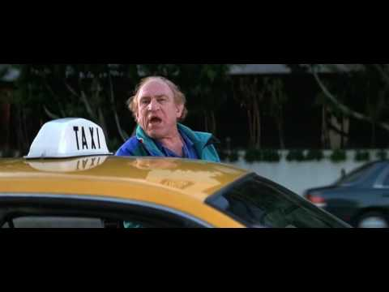
A bit of respectful humor might be a good start…

Slide 3
The Why…
Mission
UKY Community and Leadership Development
“As scholars, teachers, and practitioners in a multidisciplinary social sciences department, we create new knowledge through research, Extension and outreach. We develop and empower our students, organizations and communities to envision and achieve sustainable and equitable futures.”
UKY - Cooperative Extension Service
“Our mission, simply stated, is to make a difference in the lives of Kentucky citizens through research-based education.”

Slide 4
The Why…
Diversity and demographic shifts
Challenge traditional program and engagement models.
Opportunities, lessons learned, and success stories

Slide 5
Latinx Population Growth in Kentucky
2022
White Alone (no Hispanic) 83.2%
Black or African-American Alone. 8.7%
Latinos/Hispanics 4.3%
Asian Alone 1.8%
AIAN Alone 0.1%
Data source: https://www.census.gov/quickfacts/ky
Notes:
5

Slide 6
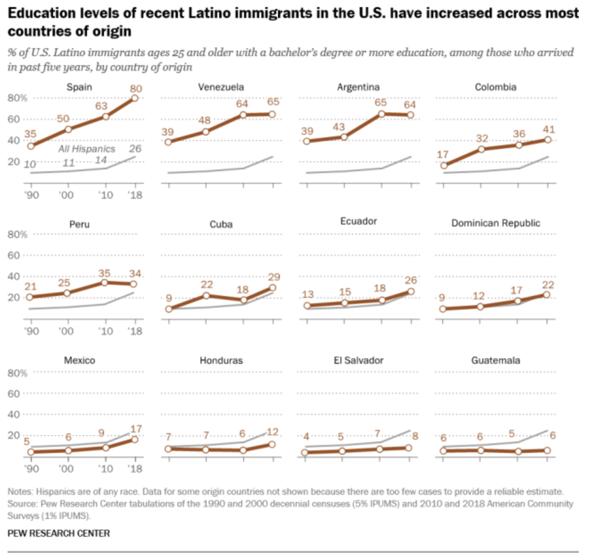

Slide 7
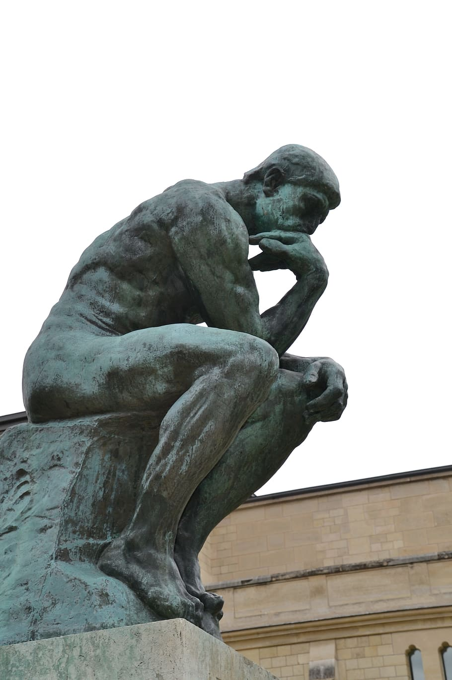
What Is Your Why?

Slide 8
Working beyond Programming as Usual
Self-Reflection & Intentionality
Innovation
New Partnerships
Review
Am I ready to engage with new audience?
Is there organizational support?
Leave Comfort Zone
What need to be done differently
What is your goal?
Know the new audience
Who are your community partners?
Establish and nurture new partnerships
Identify lessons learned
Revise engagement plan

Slide 9
What works…
Be intentional
Develop an engagement plan
Who? How? When? Where?
Get to know your community
Extension Data Resources
Census Bureau Quick Facts
County Health Ranking

Slide 10
What works…
Be intentional
Learn about the culture and context in which they live
Are there cultural differences in reference to specific topics, services, or programs?
Learn how they communicate i.e. social media vs word of mouth
Learn about the challenges to access resources
Do not assume, if unsure, ask

Slide 11
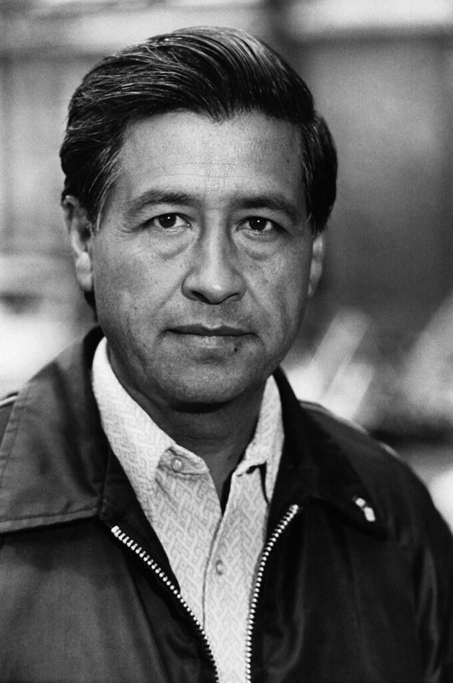
What works…
Build relationships
If you really want to make a friend,
Go to someone’s house
Ad eat with them
The people who give you their food
Give to their heart!
Cesar Chavez

Slide 12
What works...
Have a partners team
Hold a community partners meeting and identify your team
Who is your cultural broker? Who do they trust?
Recruit bilingual and bicultural volunteers
Be persistent and consistent

Slide 13
What works...
Organizational change
Commit resources
Identify State and County resources and tools available i.e. translation and interpretation funding
Provide staff development training
Hire language and cultural skills you need

Slide 14
Working beyond Programming as Usual
Self-Reflection & Intentionality
Innovation
New Partnerships
Review
Am I ready to engage with new audience?
Is there organizational support?
Leave Comfort Zone
What need to be done differently
What is your goal?
Know the new audience
Who are your community partners?
Establish and nurture new partnerships
Identify lessons learned
Revise engagement plan

Slide 15
Brainstorm
What resources are available?
Get to know your community
State and County office resources
Extension translation and interpreting resources
How to use them?
Notes:
Review Together

Slide 16
Gracias!
Q & A

